Slide 1
Project Report: Customer Retention Project by:Nishank shah| Fliprobo Internship | Batch 1823 – Datatrained |

Slide 2
Problem Statement: -Analysis of Retail factors for customer activation and retention: A case study from Indian e-commerce customers

Slide 3
INTRODUCTION
The Indian e-retail market is rising exponentially, as is competitiveness among marketers. The performance of the online retail store depends on the amount of customers it draws and the same becomes a determining factor for the strategic edge.
Excluding robust and sustained visitor traffic from multiple sources, it would be almost difficult for a digital retail store to be successful. However, it is necessary to ascertain that the traffic is of good quality, consisting of users who are involved in the online transaction

Slide 4
IMPORTING IMPORTANT LIBRARIES
Imported pandas, numpy, matplotlib and seaborn. Also imported warnings to ignore the warnings. There are 2 features ‘subject’ and ‘message’ and a label having values 0 and 1. Here 0 indicates not-spam (also called ‘ham’) and 1 indicates ‘spam’

Slide 5
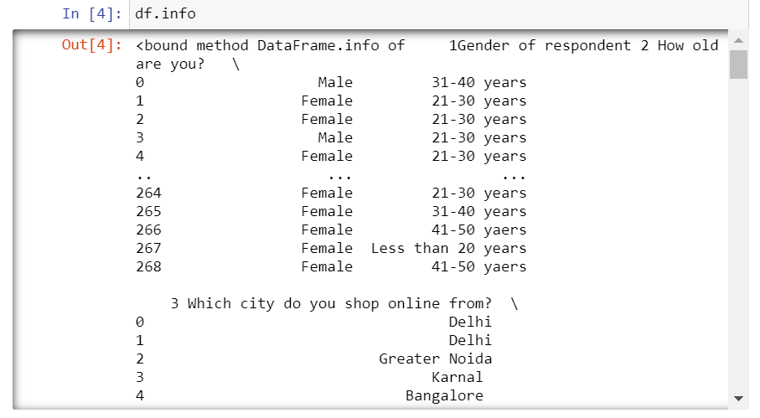
DATA ANALYSIS The graph below shows the datatypes . It can be observed that there are a large number of columns which are mostly categorical, interval scale or rating scale.
The graph below shows the datatypes . It can be observed that there are a large number of columns which are mostly categorical, interval scale or rating scale.

Slide 6
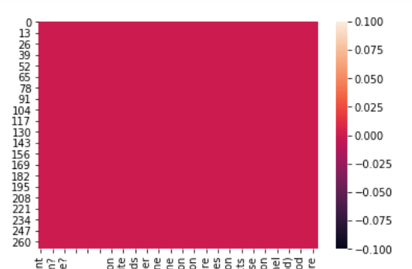
NULL VALUES
A heatmap shows that there are no null values in the dataset

Slide 7
I have started by analyzing and plotting the most common features which are considered by the consumers in order to make purchase decisions or decisions related to the choice of e-commerce platform.
This is based on the literature review and study of articles as part of my secondary research
I have summarized the results at the end

Slide 8
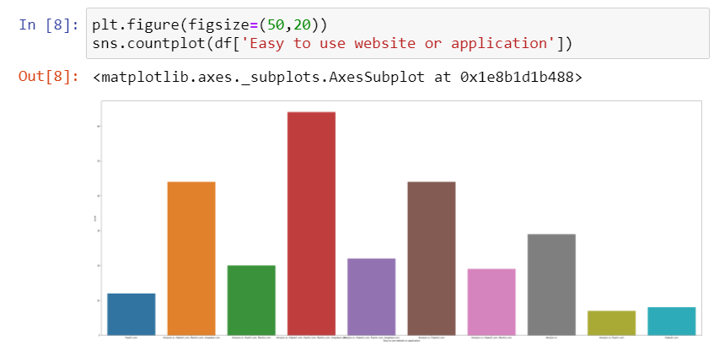
EASE OF USE OF WEBSITE AND INTERFACE

Slide 9
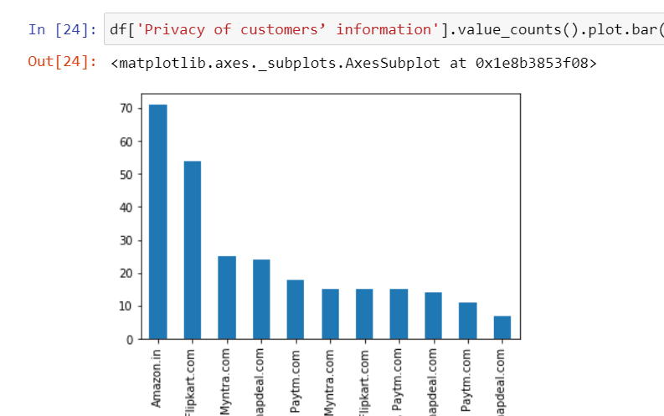
PRIVACY OF INFROMATION

Slide 10
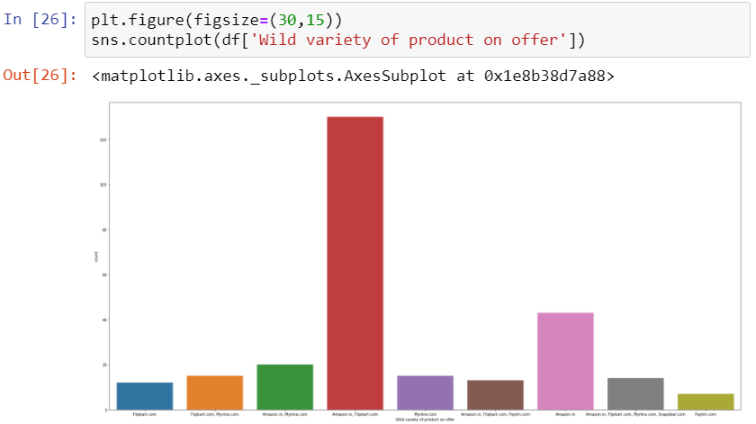
VERIETY OF PRODUCTS OFFERED

Slide 11
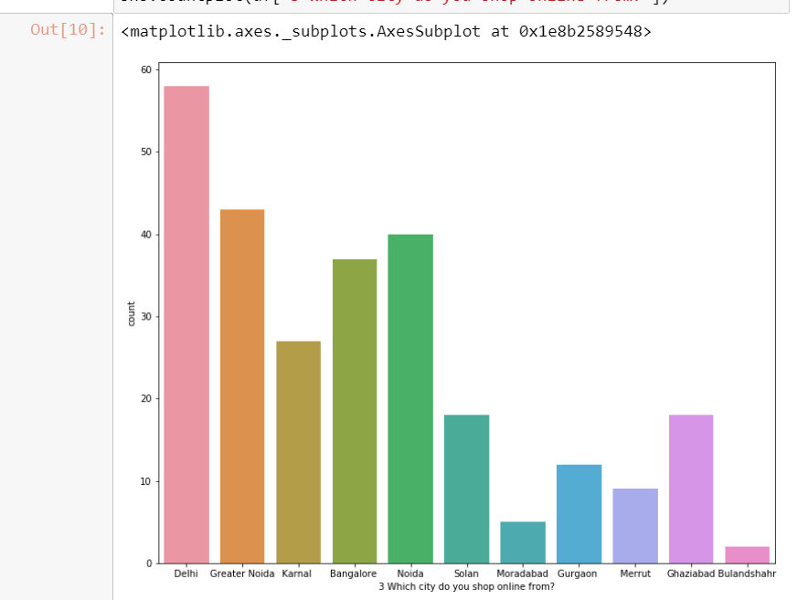
ANALYSIS SHOWING THE DISTRIBUTION AND GEOGRAPHICAL CONCENTRATION OF THE CONSUMERS

Slide 12
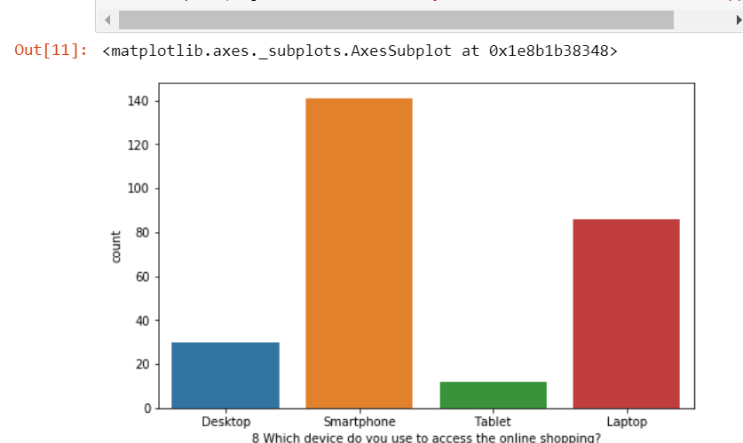
CHOICE OF DEVICE USED FOR ONLINE PURCHASE AND THE SOURCE OF INTERNET

Slide 13
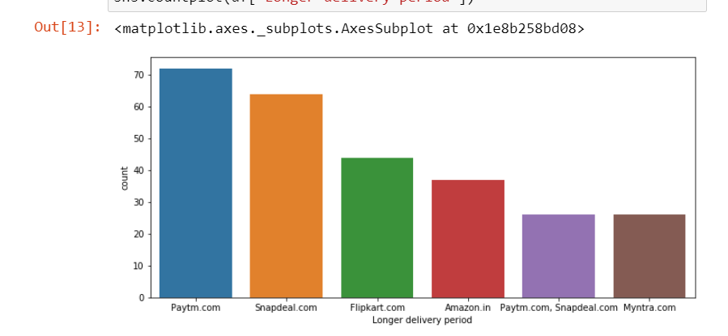
DELIVERY PERIOD- CHOICE OF THE ECOMMERCE WEBSITE

Slide 14
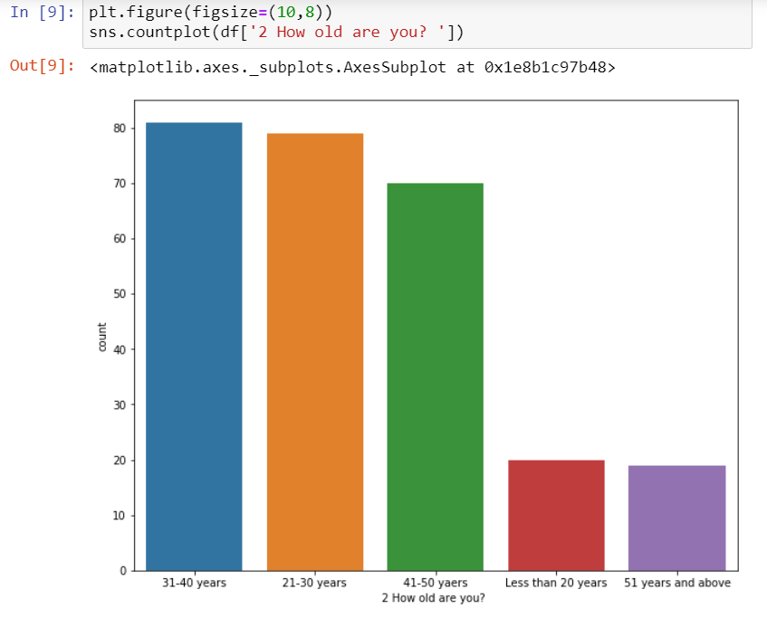
AVERAGE AGE OF RESPONDANTS WHO WERE USING THESE PLATFORMS

Slide 15
SOME OF THE OBSERVATIONS FROM THE DATA ANALYSIS ARE-
Amazon and flipkart offer maximum veriety of products
Majority of the respondents are concentrated in Delhi
Smartphone is the most commonly used device for online shopping
Most people use mobile internet for shopping

Slide 16
Continued..
Based on perceived trustworthiness Amazon is the website that people would recommend
Most people think that shopping online is more convenient that shopping offline
Most customers have been shopping for more than years in thi study
Search engine marketing is the most common type of marketing channel used

Slide 17
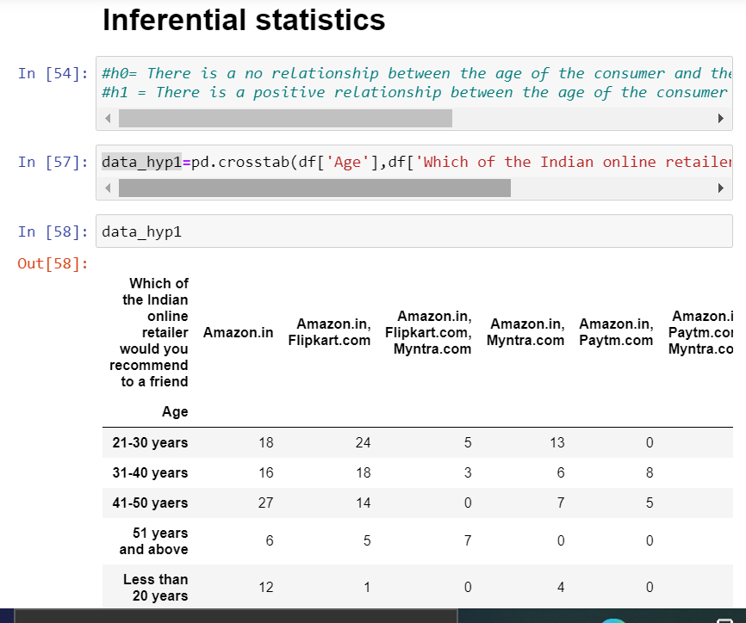

Slide 18
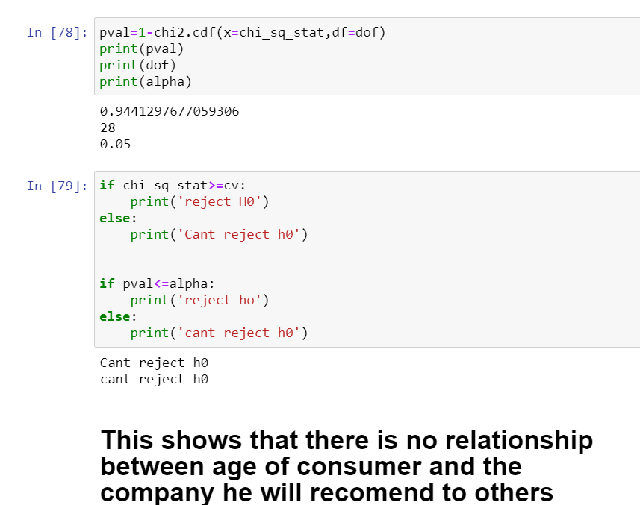

Slide 19
Here I have experimented with just one hypothesis that I formed and used chi-square test as a method of inferential statistics
Ultimately the result suggested not to reject the null hypothesis showing no major relationship between the age of consumer and the company he recommend

